Slide 1
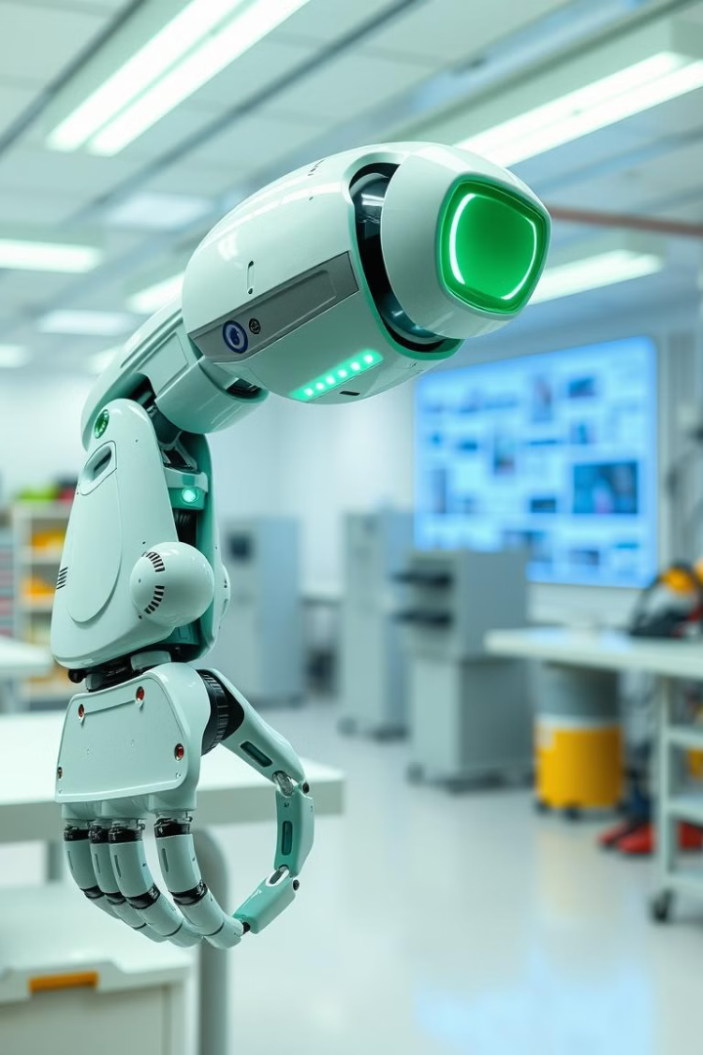

Robot Arm Control: Implementing an Intelligent Agent
This presentation explores the development of an intelligent agent to control a robotic arm. The agent will be designed to perform a pick-and-place task, involving object recognition, motion planning, and closed-loop control.

Slide 2

Introduction to Robotic Arm Systems
1
Articulated Structure
2
Actuators and Sensors
3
End Effectors
Robotic arms consist of a series of links connected by joints, enabling them to reach various positions and orientations.
Motors drive the joints, while sensors like cameras and tactile sensors provide feedback about the environment.
The end effector is the tool at the arm's tip, designed for specific tasks like grasping, welding, or painting.
4
Applications
Robotic arms are widely used in manufacturing, assembly, healthcare, and research.

Slide 3
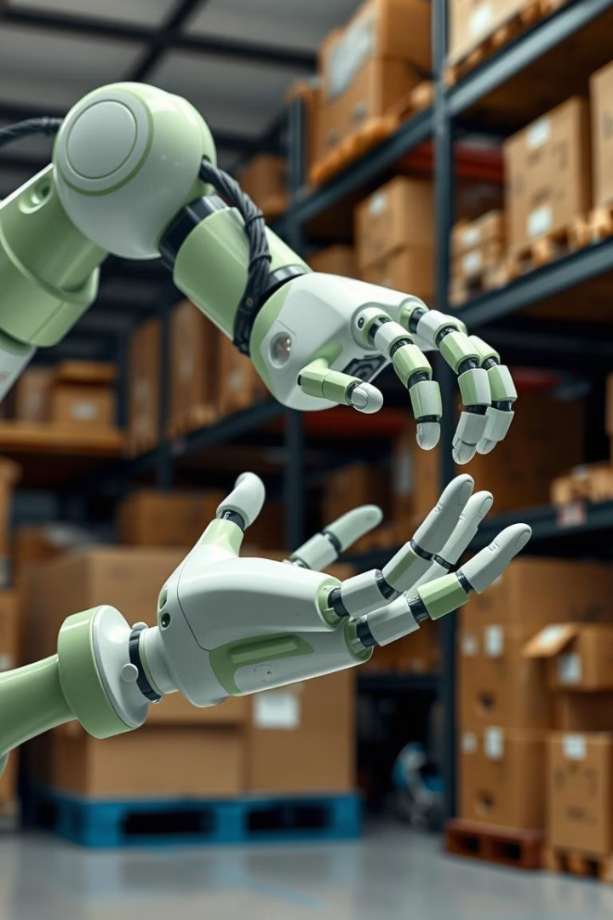
Defining the Task: Pick and Place Objects
1
Object Identification
The agent needs to accurately identify the object to be picked up, its location, and orientation.
2
Motion Planning
The agent must plan a safe and efficient trajectory for the arm to reach the object and place it at the target location.
3
Grasping and Placement
The agent must control the arm to grasp the object securely and then release it at the target position without dropping it.

Slide 4

Sensing and Perception: Identifying Objects
Vision Systems
Depth Sensors
Object Recognition
Cameras capture images of the environment, which are then processed by algorithms to detect objects, their shapes, and positions.
Depth sensors provide information about the distance to objects, enabling the agent to understand the 3D layout of the environment.
Machine learning algorithms are trained to recognize objects based on their visual features and classify them into categories.

Slide 5





Motion Planning: Calculating Arm Movement
Start State
The initial position and orientation of the robot arm are defined.
Goal State
The desired position and orientation of the arm at the target location are specified.
Path Planning
Algorithms are used to find a feasible and optimal path for the arm to move from the start to the goal state while avoiding obstacles.
Trajectory Generation
A smooth and continuous trajectory is generated based on the planned path, ensuring safe and accurate movement.

Slide 6

Control Strategies: Closed-Loop Control
Closed-Loop Control
Open-Loop Control
Uses feedback from sensors to adjust control signals
Does not use feedback, relies on pre-programmed commands
More robust to disturbances and uncertainties
Less accurate and prone to errors
Used for precise and dynamic tasks
Suitable for simple and predictable tasks

Slide 7
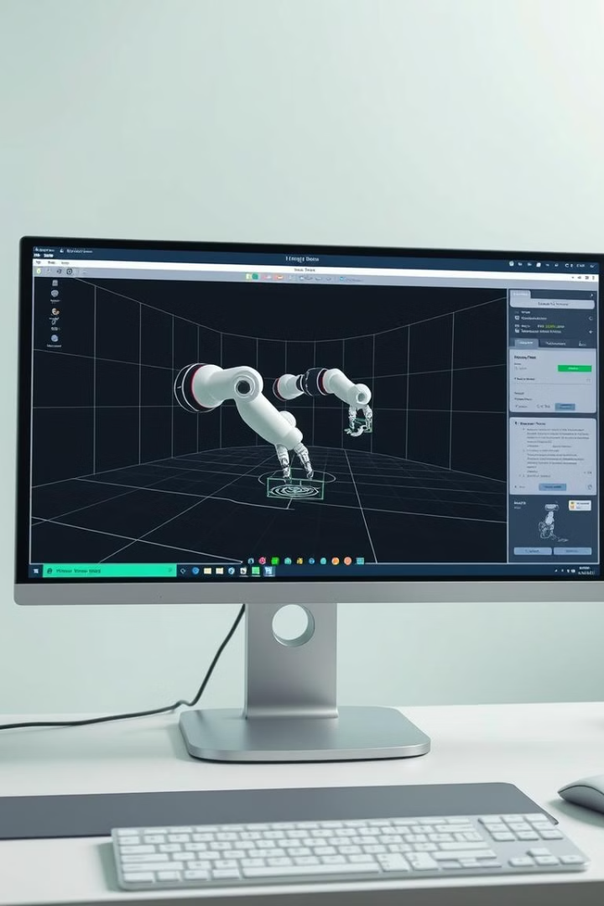
Simulation and Testing: Validating the System
Virtual Environments
Performance Evaluation
Simulations provide a safe and controlled environment to test the agent's performance without risks to physical hardware.
Metrics such as accuracy, speed, and smoothness of movement are used to evaluate the agent's capabilities.
Optimization and Refinement
Simulation results are analyzed to identify areas for improvement and refine the agent's control algorithms.

Slide 8





Dealing with Uncertainty and Errors
Sensor Noise
Arm Calibration
Sensors can introduce noise and inaccuracies in measurements, leading to errors in object detection and motion planning.
Imperfect calibration of the robot arm can result in deviations from intended trajectories.
Object Variability
Adaptive Control
Objects may vary in size, shape, and texture, requiring the agent to adapt its control strategies.
The agent should be able to adapt its control strategies to handle uncertainties and errors, ensuring successful task completion.

Slide 9
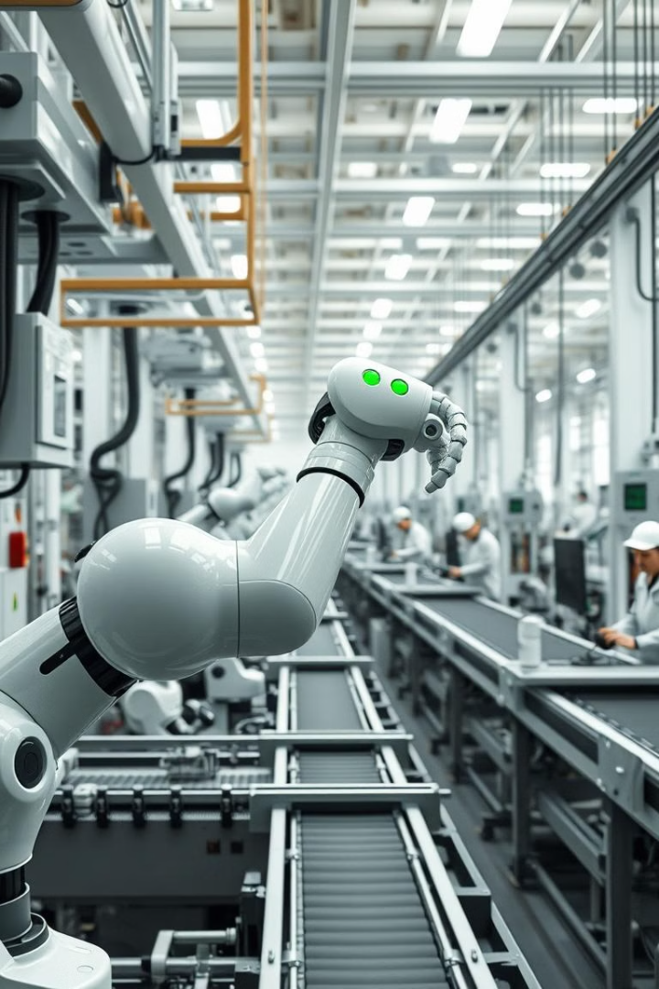
Real-World Implementation Challenges
1
Safety
2
Environmental Factors
The agent must be designed to operate safely in close proximity to humans and other equipment.
The agent must be robust to changes in lighting, temperature, and other environmental factors that can affect sensor performance.
3
Scalability
The agent should be able to handle a variety of tasks and environments, allowing for flexible deployment in different applications.

Slide 10
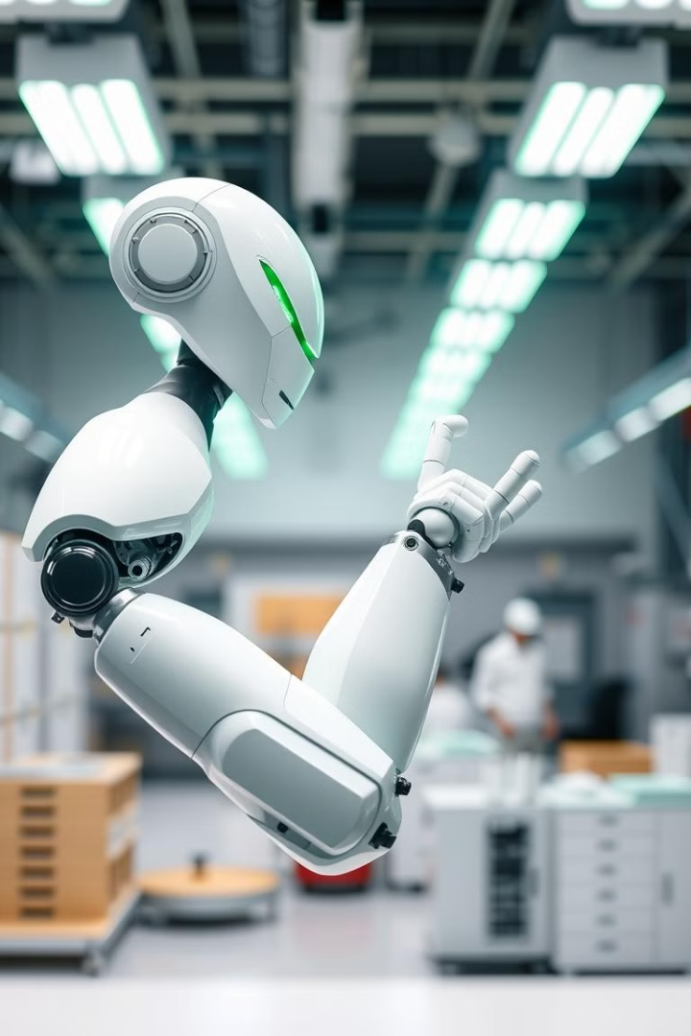
Conclusion and Future Developments
The development of an intelligent agent for controlling a robot arm is an active area of research. Future advancements in areas like machine learning, sensor technology, and computational power will enable the development of even more sophisticated and capable robotic systems.

